Slide 1
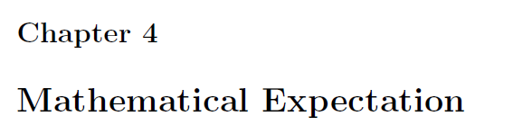

Slide 2
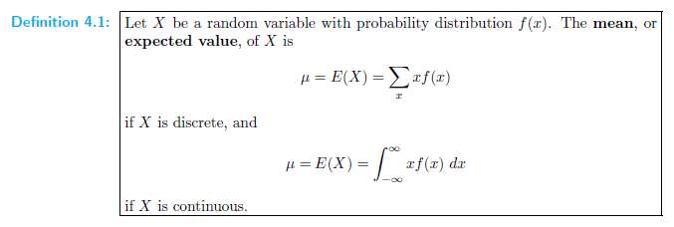

Slide 3

variance
E(X²)=$\sum{X^{2}f(x)}$
E(X³)=$\sum{X^{3}f(x)}$
Var(X)= E(X²)-E(X)²

Slide 4
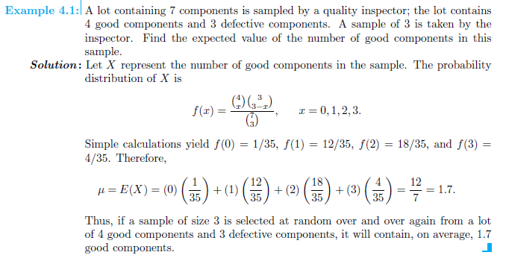

Slide 5
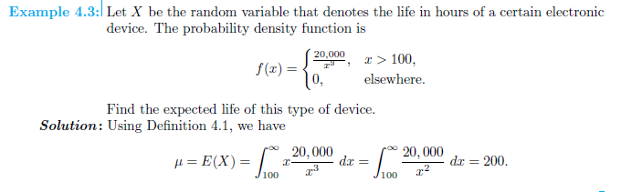

Slide 6
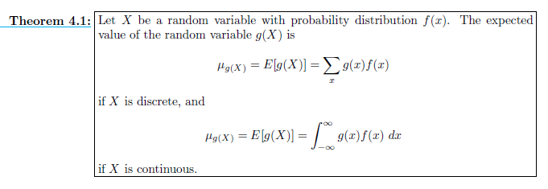

Slide 7
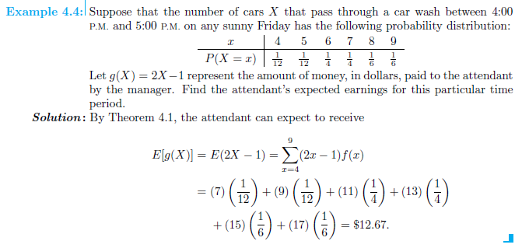

Slide 8
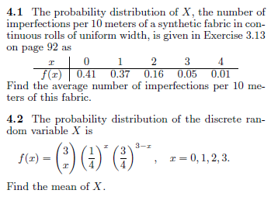
Solve: Q 4.6, 4.4, 4.7

Slide 9
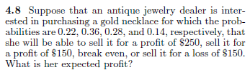

Slide 10
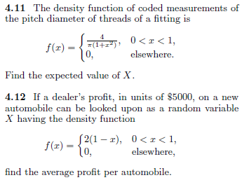

Slide 11
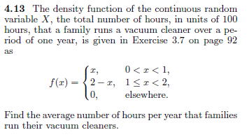

Slide 12
solve
Q 4.17, 4.22, 4.28, 4.29,4.30, 4.32

Slide 13
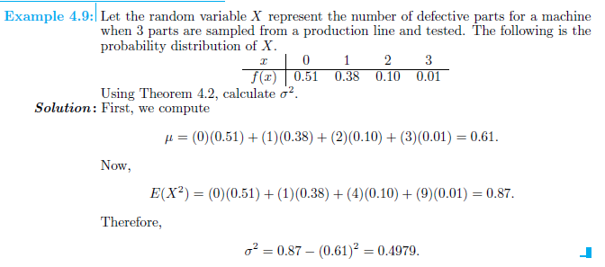

Slide 14
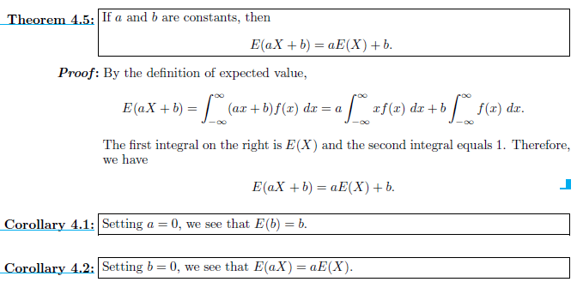

Slide 15
